Slide 1
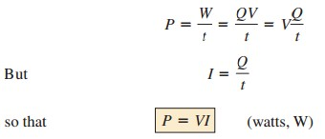
College of Engineering Dept. of the electrical power and Machine engineering
Subject / Electrical Eng. Fundamental I
stage / first Date: 13/11/2018 Lecture:3
Time/ 2 hours
Thermal energy, W_{th}
W_{th} = mc ΔT m = mass
C = specific heat capacity is the heat required to rise the temperature of 1 Kg of substance by 1 degree
(J/Kg.K)
Example: Owing to a short circuit, a copper conductor having a cross sectional area of 25 mm² carries current of 20000 A for 30 milliseconds. Neglecting heat loss, calculate the temperature rise of the conductor. Assume the specific heat capacity of copper to be 390 J/Kg.k, density to be 8900 Kg/m³ and resistivity to be 0.018 µΩm.
Solution: since heat loss neglected, then all the electric power or electric energy is converted to thermal energy i.e. W_{e}= W_{th}
W_{e} = P.t = I²R t, W_{th} = mc ΔT
The volume of conductor, V = A.L W_{e}= W_{th}
I²R t = mc ΔT
I² ρ^{𝐿𝐿} t = ρ Vc ΔT
𝐴𝐴
d
Where ρ_{d} is the density
I² ρ^{𝐿𝐿} t = ρ A.L c ΔT
𝐴𝐴
d
₌ 2(20 000)2∗0.18∗10−6∗30∗10−3_{= 0.216/2.169*10-3 = 99.585 K}
_{ΔT =} i 2 ρ𝑡𝑡
𝐴𝐴2 ρd c (25∗10−6)2∗8900.390
POWER
the term power is applied to provide an indication of how much work (energy conversion) can be accomplished in a specified amount of time; that is, power is a rate of doing work.
with the energy (W) measured in joules and the time t in seconds
P = Fu P = ωT
By direct substitution of Ohm’s law, the equation for power can be obtained in two other forms:

Slide 2
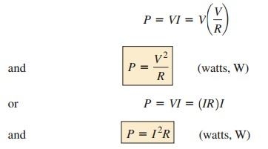
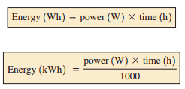
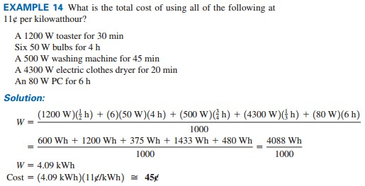
College of Engineering Dept. of the electrical power and Machine engineering
Subject / Electrical Eng. Fundamental I
stage / first Date: 13/11/2018 Lecture:3
Time/ 2 hours
The power supplied by a battery can be determined by
The importance of Eq. above cannot be overstated. It clearly states the following: The power associated with any supply is not simply a function of the supply voltage. It is determined by the product of the supply voltage and its maximum current rating.
ENERGY
For power, which is the rate of doing work, to produce an energy conversion of any form, it must be used over a period of time.
Since power is measured in watts (or joules per second) and time in seconds, the unit of energy is the watt second or joule (note Fig. 15). The watt second, however, is too small a quantity for most practical purposes, so the watthour (Wh) and the kilowatt hour (kWh) are defined, as follows:
consider that 1 kWh is the energy dissipated by a 100 W bulb in 10 h
The kilowatthour meter is an instrument for measuring the energy supplied to the residential or commercial user of electricity

Slide 3
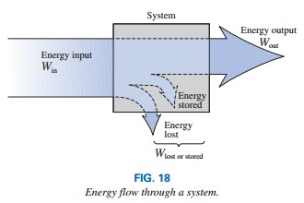
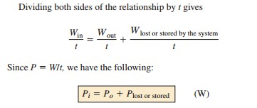
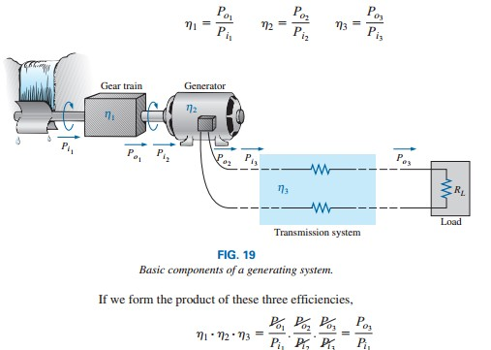
College of Engineering Dept. of the electrical power and Machine engineering
Subject / Electrical Eng. Fundamental I
stage / first Date: 13/11/2018 Lecture:3
Time/ 2 hours
EFFICIENCY
Energy input = energy output + energy lost or stored by the system
In terms of the input and output energy, the efficiency in percent is given by

Slide 4
College of Engineering Dept. of the electrical power and Machine engineering
Subject / Electrical Eng. Fundamental I
stage / first Date: 13/11/2018 Lecture:3
Time/ 2 hours
and substitute the fact that p_{i2}=p₀₁ and p_{i3}= p_{o2}, we find that the quantities indicated above will cancel, resulting in p_{o3}/p_{i1} , which is a measure of the efficiency of the entire system.
Q1: A hydro-electric generating plant is supplied from a reservoir of capacity 20*10⁶ m³ with ahead of 200m. The hydraulic efficiency of the plant is 0.8 and the electric efficiency is 0.9. what is the total available energy ?
Q2: A hydro-electric generating plant is supplied from a reservoir has ahead of 200m. The hydraulic efficiency of the plant is 0.8 and the electric efficiency is 0.9. The plant supplies a load of 12 MW for 4 hours. Calculate the fall in the level of the reservoir during this period if the area of the reservoir is 3Km².
Q3: the reservoir in the previous problem is a supplied by a river at the rate of 2m3/sec. Assuming constant head efficiency, what does this flow represent in terms of mega watts, mega
watt hours per day and giga watt hours per annum?

